Slide 1
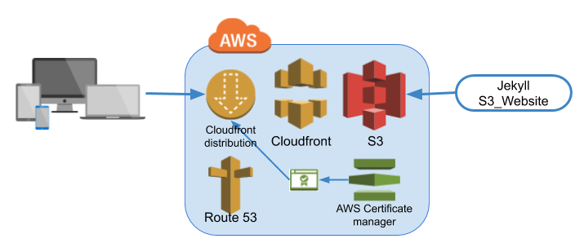
AWS S3

Slide 2
What is AWS S3?
• S3 = Simple Storage Service
• Object storage for files and data
• Store and retrieve any amount of data
• Scalable, secure, and highly available
• Commonly used for backups, websites, and data archiving

Slide 3
S3 Key Concepts
• Buckets: Containers for storing objects
• Objects: Files (data + metadata)
• Keys: Unique name for each object in a bucket
• Region: Physical location of your data
• Storage Classes: Different cost & access levels

Slide 4
Steps to Create an S3 Bucket
1. Login to AWS Console
2. Go to S3 service
3. Click 'Create Bucket'
4. Enter Bucket Name and choose Region
5. Set options (versioning, encryption, etc.)
6. Set permissions (access control)
7. Click 'Create'

Slide 5
S3 Storage Classes
• S3 Standard – Frequent access
• S3 Intelligent-Tiering – Auto cost saving
• S3 Standard-IA – Infrequent access
• S3 One Zone-IA – Infrequent, single zone
• S3 Glacier – Archive with retrieval time
• S3 Glacier Deep Archive – Long-term storage

Slide 6
S3 Permissions & Security
• IAM Policies: Who can access what
• Bucket Policies: Control access at bucket level
• ACLs: Legacy access control
• Encryption: Server-side (SSE) and client-side
• Versioning and MFA Delete for protection

